Slide 1

Wireless Power Transfer
C1C Henry
C1C Hermanson
C1C Pak
C1C Singh
1

Slide 2
Overview
Executive Summary
Technical Discussion
Motivation
Problem Statement
Related Work
Methodology
Results
Discussion
Future Work
Questions?

Slide 3
Executive Summary
During this presentation, we will discuss what WPT is, and the vulnerabilities associated with it. We will also discuss our progress experimenting with its exploitation and what we plan on doing with that information. Finally, we will consider the long-term implications of this capstone project.

Slide 4
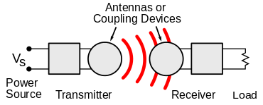
Technical Discussion
WPT is wireless point to point transmission of electrical energy
Many implementations but Qi is the industry standard
Alternatives: AirFuel, Proprietary Near Field Magnetic Coupling, RF, Ultrasound
Delivers a variable amount of voltage to device depending on power requirements (5-15 Watts)
New technology that lacks security capabilities and has vulnerabilities
Malicious messages can be sent between transmitter and receiver to alter power transmission
Messages between transmitter and receiver can be observed to gain information about receiver

Slide 5
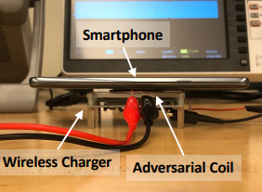
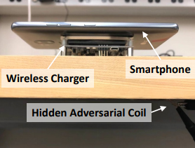
WPT Attack Vectors
Hijacking
Injection of adversarial magnetic signals on the power transmitter to hijack the communication channel
Disruption of magnetic field (via well crafted injection) between transmitter and receiver – cause inefficient power transfer
Control of power transfer process
Eavesdropping
Qi has lack of encryption and authentication mechanisms
Snoop communication between transmitter and receiver
Infer activity of receiver device
Q ID & C allows basic device identification

Slide 6
Motivation
Wireless Power Transfer could become a common function of new technology
Exploit techniques and results found in this experiment can potentially be generalized
This research will create a foundation for further experimentation and TTP development
Findings can be expanded to other wireless non-networked point-to-point connections

Slide 7
Problem Statement
IDENTIFY
What vulnerabilities exist within systems via wireless power transfer; how can these vulnerabilities be exploited and defended against?
APPLY
The initial phase of this research includes the reproduction and expansion of research related to injection based hijacking of the charging process and non-intrusive eavesdropping of the charging process allowing for interpreted analysis of device activity.
EXPAND
This serves as the initial point of research to be provided to the National Reconnaissance Office (NRO) and help observe various other methods of similar side-channel attacks such as taking advantage of point-to-point communication capabilities.

Slide 8
Related Works
CoDoC: A Novel Attack for Wireless Rechargeable Sensor Networks through Denial of Charge
Safe and secure wireless power transfer networks: challenges and opportunities in RF-based systems
Wireless Charging Power Side-Channel Attacks

Slide 9
Summary of Related Work
CoDoC: A Novel Attack for Wireless Rechargeable Sensor Networks through Denial of Charge
WPT networks susceptible to Denial of Charge (DoC) attacks
Can disrupt network reliability, network functionality, and possible trigger event loss
Safe and secure wireless power transfer networks: challenges and opportunities in RF-based systems
Handful of attacks – safety, charging, interference, spoofing, software, and monitoring attacks
Countermeasures should be implemented as small and energy-efficient protocols to ensure safe and secure energy transfer

Slide 10
Summary of Related Work cont.
Wireless Charging Power Side-Channel Attacks
discuss how the amount of current being drawn from the charger can be used to determine which applications are being used by the mobile device
Shows weaknesses of such attacks
For example, the longer a device is being used, the less accurate the estimate is

Slide 11
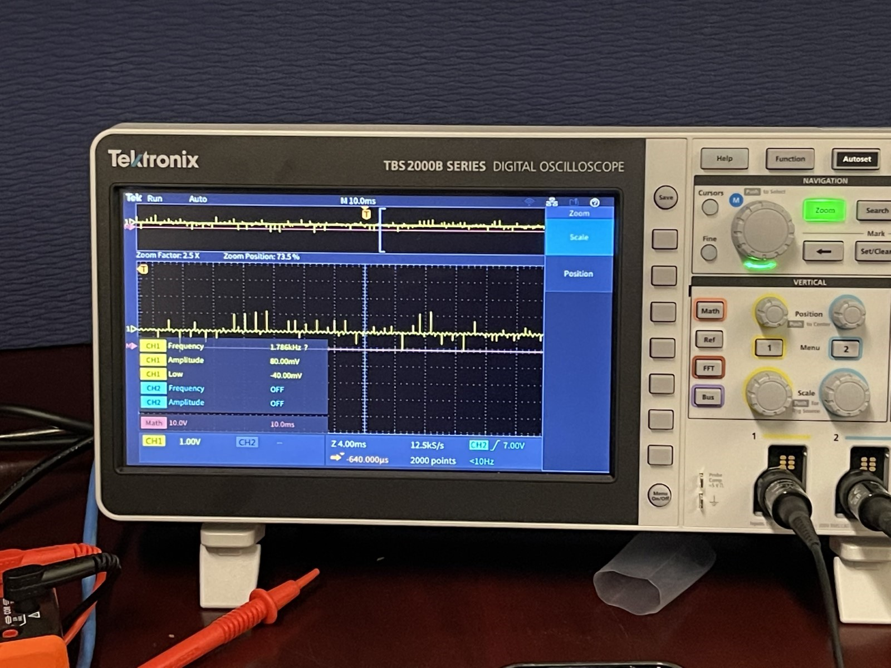
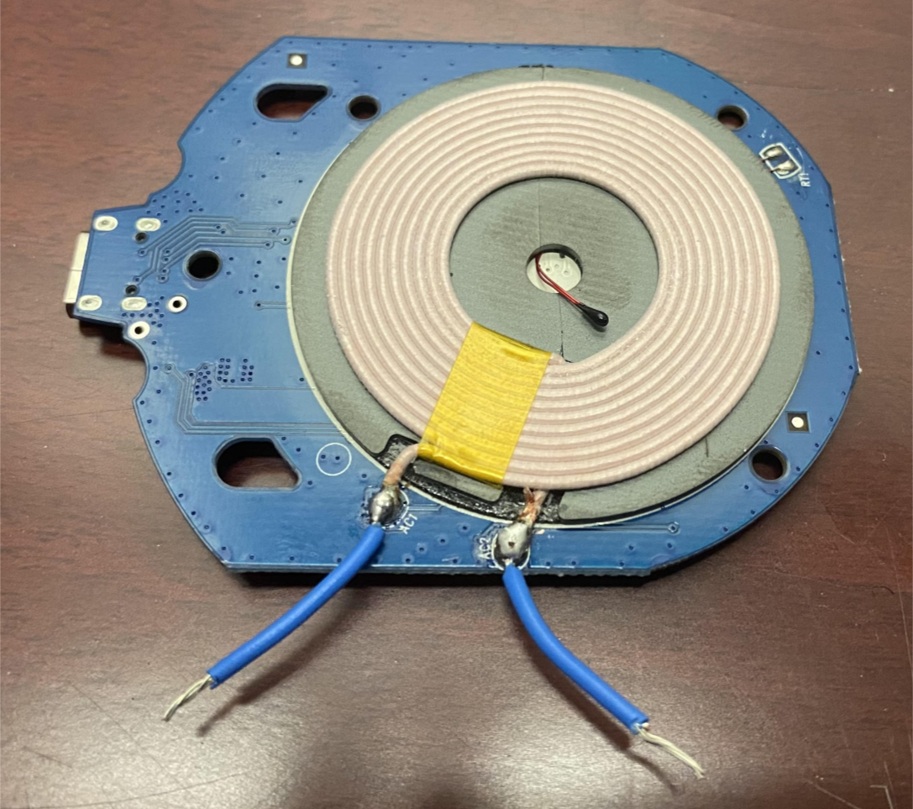
Methodology
Began by taking inventory of all equipment and creating a list of needed equipment using the Security of Qi Standards research paper and experiment as a guide
Soldered leads onto the stripped coils from the wireless chargers to begin taking initial reads of the Qi communications
From this point focused on analyzing the readouts from the oscilloscope to attempt to demodulate the bits and determine the communication process of Qi standard adhering equipment
Major problem arose in the form of demodulation as we are currently unable to extrapolate exact bits from the oscilloscope

Slide 12
Results
Setup experimental environment
Acquired necessary materials
Learned how to use tools
Researched WPT technology and vulnerability

Slide 13
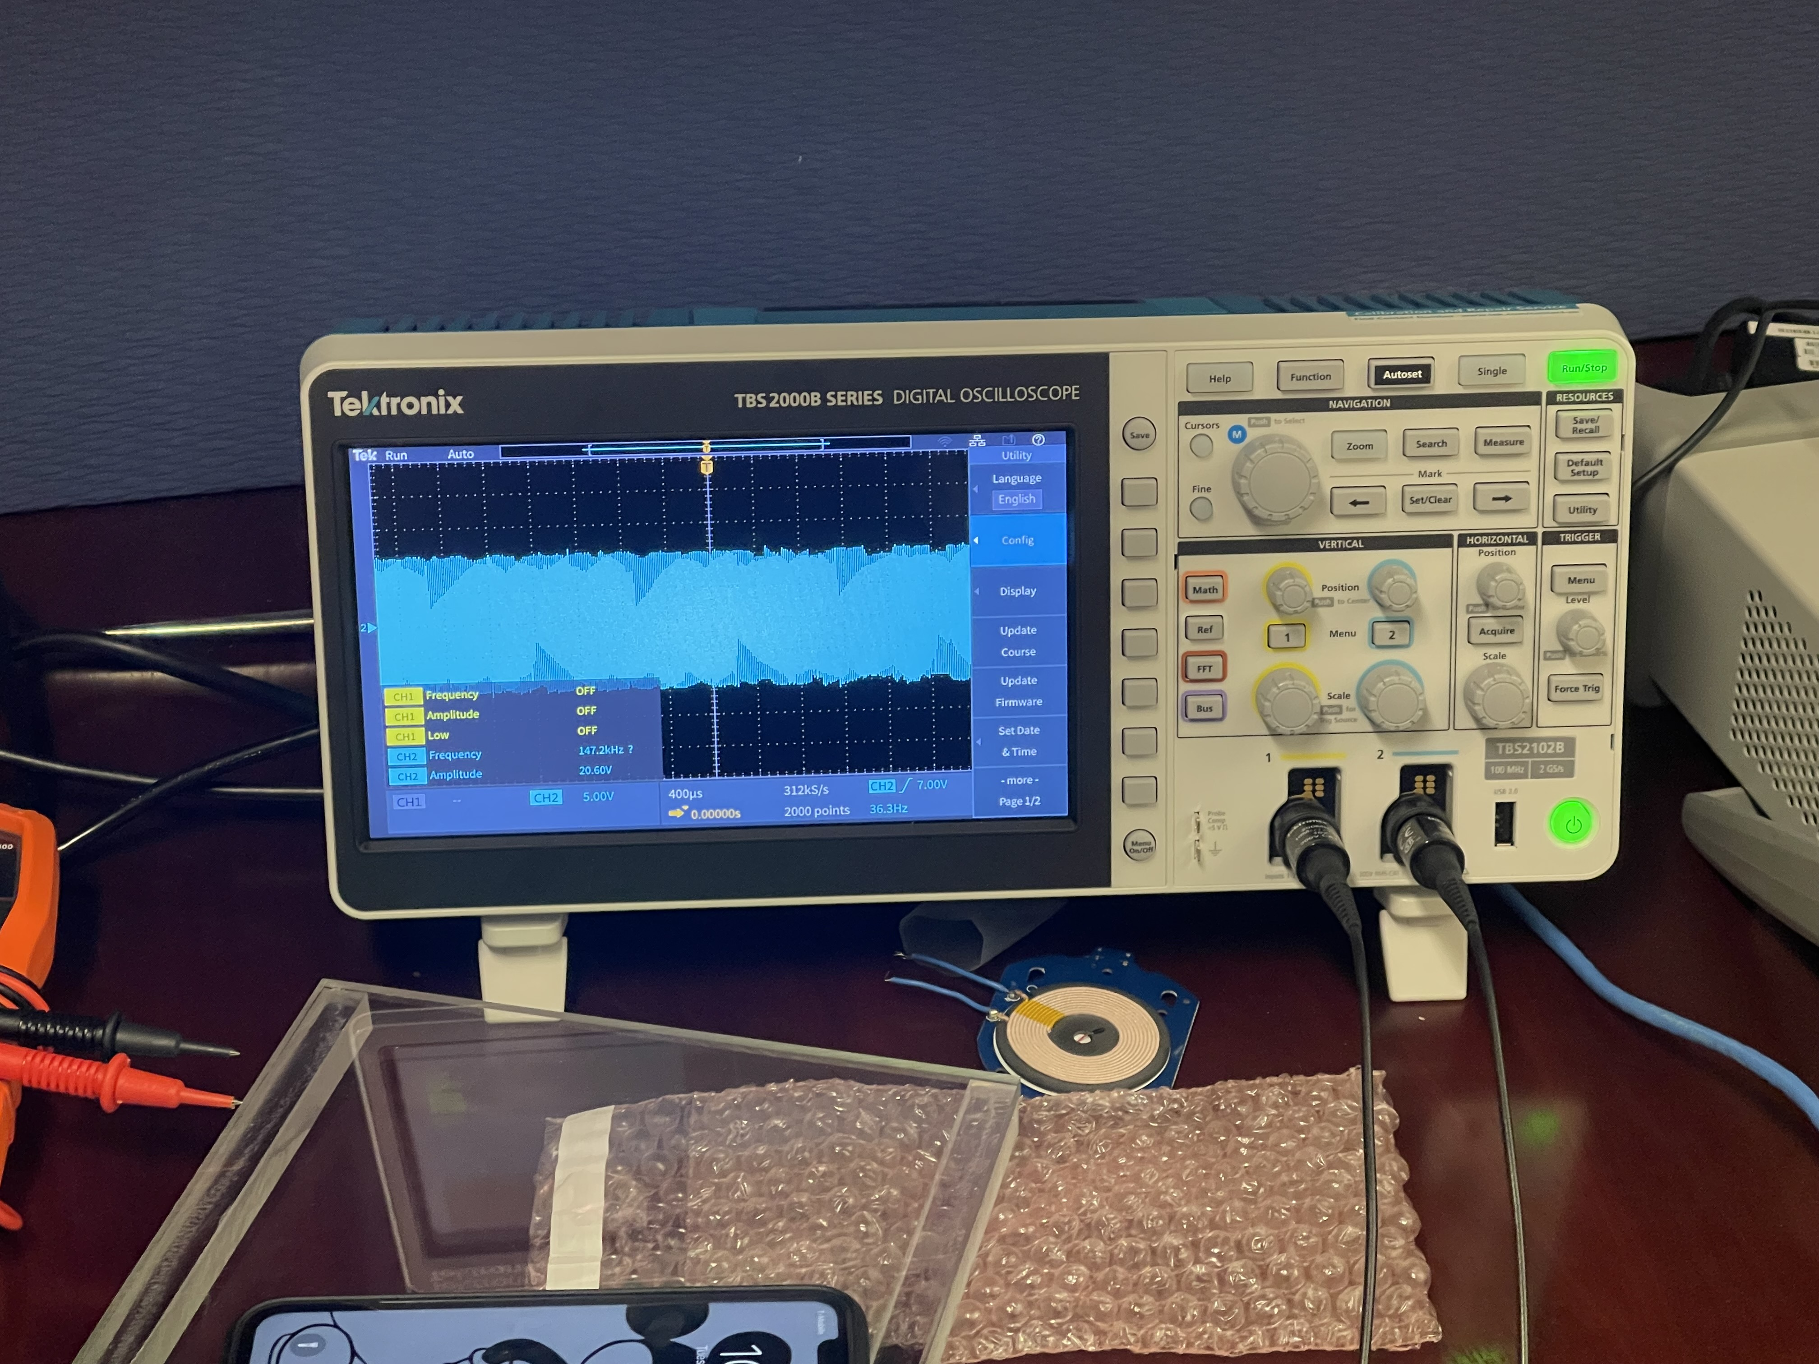
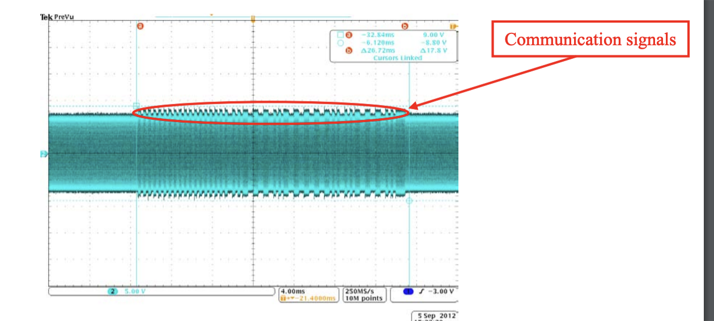
Discussion
Observed phone interacting with charger
Achieved baseline knowledge of tools
Limiting factors
Lack of equipment
Limited knowledge on how to use tools
Difficulty with oscilloscope
Our data doesn't match reading data
Problems applying filters
Challenge in demodulating captured signal to observe Qi data communications

Slide 14
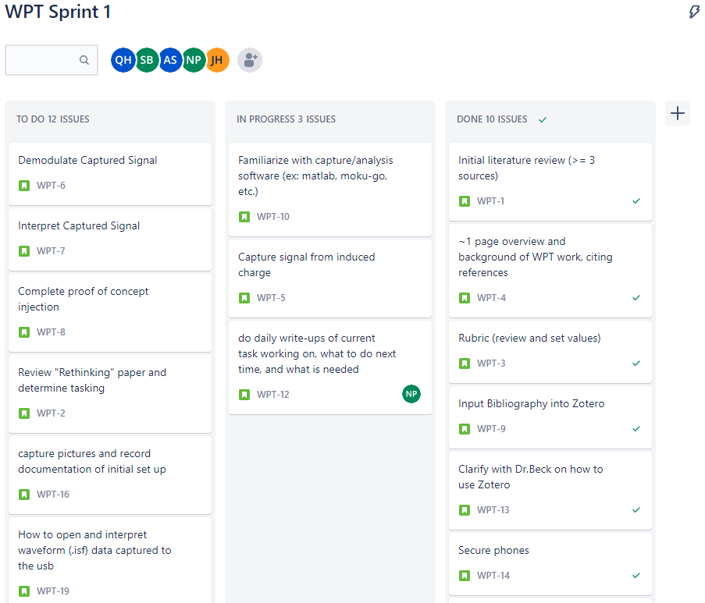
Sprint Organization
Utilized Jira Software to track the sprint process

Slide 15
Sprint 2 Taskers and Discussion
The primary goal of Sprint 2 will be to demodulate the carrier signal between the transmitter and receiver to analyze and inspect the Qi communication data being transmitted
Proof of Concept Injection experiment utilizing the waveform generator (phone dependent)
Once the phones are acquired we will be able to reproduce the previous experiment working to adversarial injection and eavesdropping

Slide 16
Future Work
Modification of Qi packets
Qi communication packets are interpreted on the receiver device, modification of the data component within the Negotiation Phase may allow code execution or data exfiltration on the receiver device
Applications with laser-based point-to-point communication
Development of Qi Protection Mechanisms
Hardware or Software based cryptography
Injection/packet modification detection

Slide 17
Questions?

Slide 18

18

Slide 19
Things you might want to include as backup slides
How did you split the work on your team
What resources did you use? Trello? Some other document?
Slides/presentations which tell your story.

